Slide 1
Smart Home Managing Application
소프트웨어공학전공 최재원

Slide 2
Project Idea
ER - Diagram
User Interface
Database
Server
URL
Execute
INDEX
목차

Slide 3
프로젝트 기본 아이디어
스마트홈 아파트 단지 구성
스마트홈 구조
Project
Contents

Slide 4







프로젝트 기본 아이디어
Smart Home Managing Application
IOT
Power

Slide 5


스마트홈 아파트 단지
Smart Home Apartment Complex
5
50

Slide 6



스마트홈 구조
Smart Home Structure
베란다
화
장
실
개인방
IOT
Power
복도
거실
화
장
실
개인방
베란다
부엌

Slide 7
ER - Diagram
Class Diagram
Diagram

Slide 8
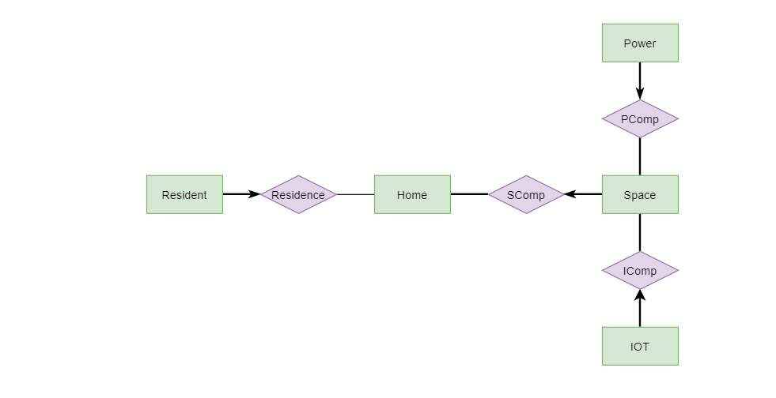
ER - Diagram
Entity Relations

Slide 9
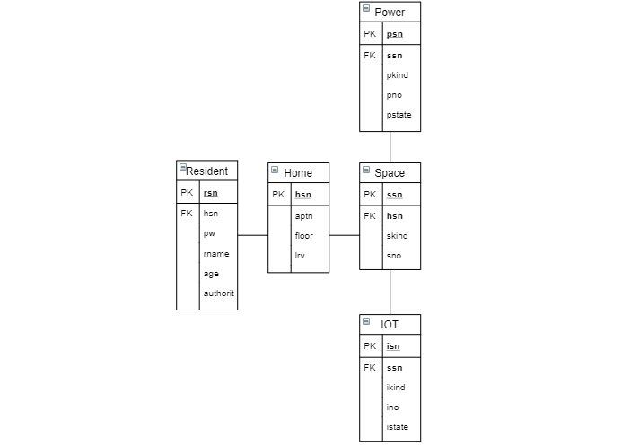
Class Diagram
Class Relations

Slide 10
Page Interface
Page HTML code
Page Python code
Page 질의문
User
Interface

Slide 11
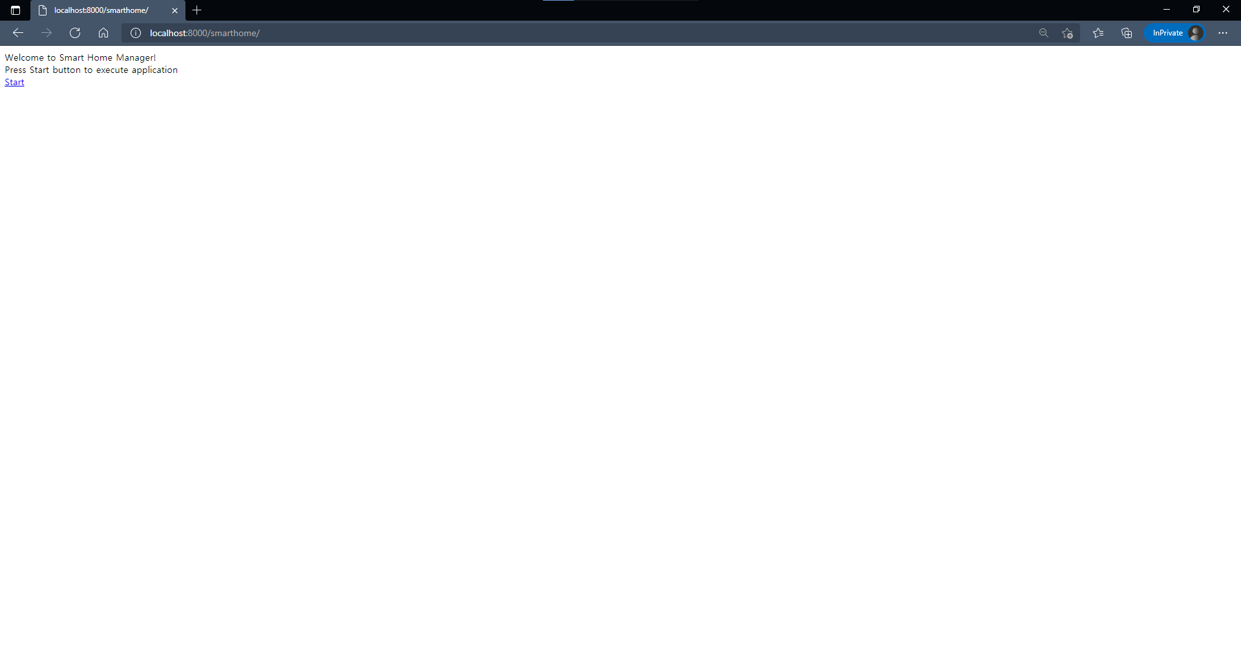
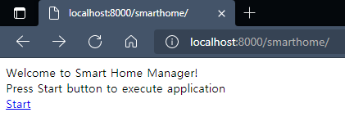


Starting Page Interface
Page Interface
UI
No
Query
HTML
Python

Slide 12
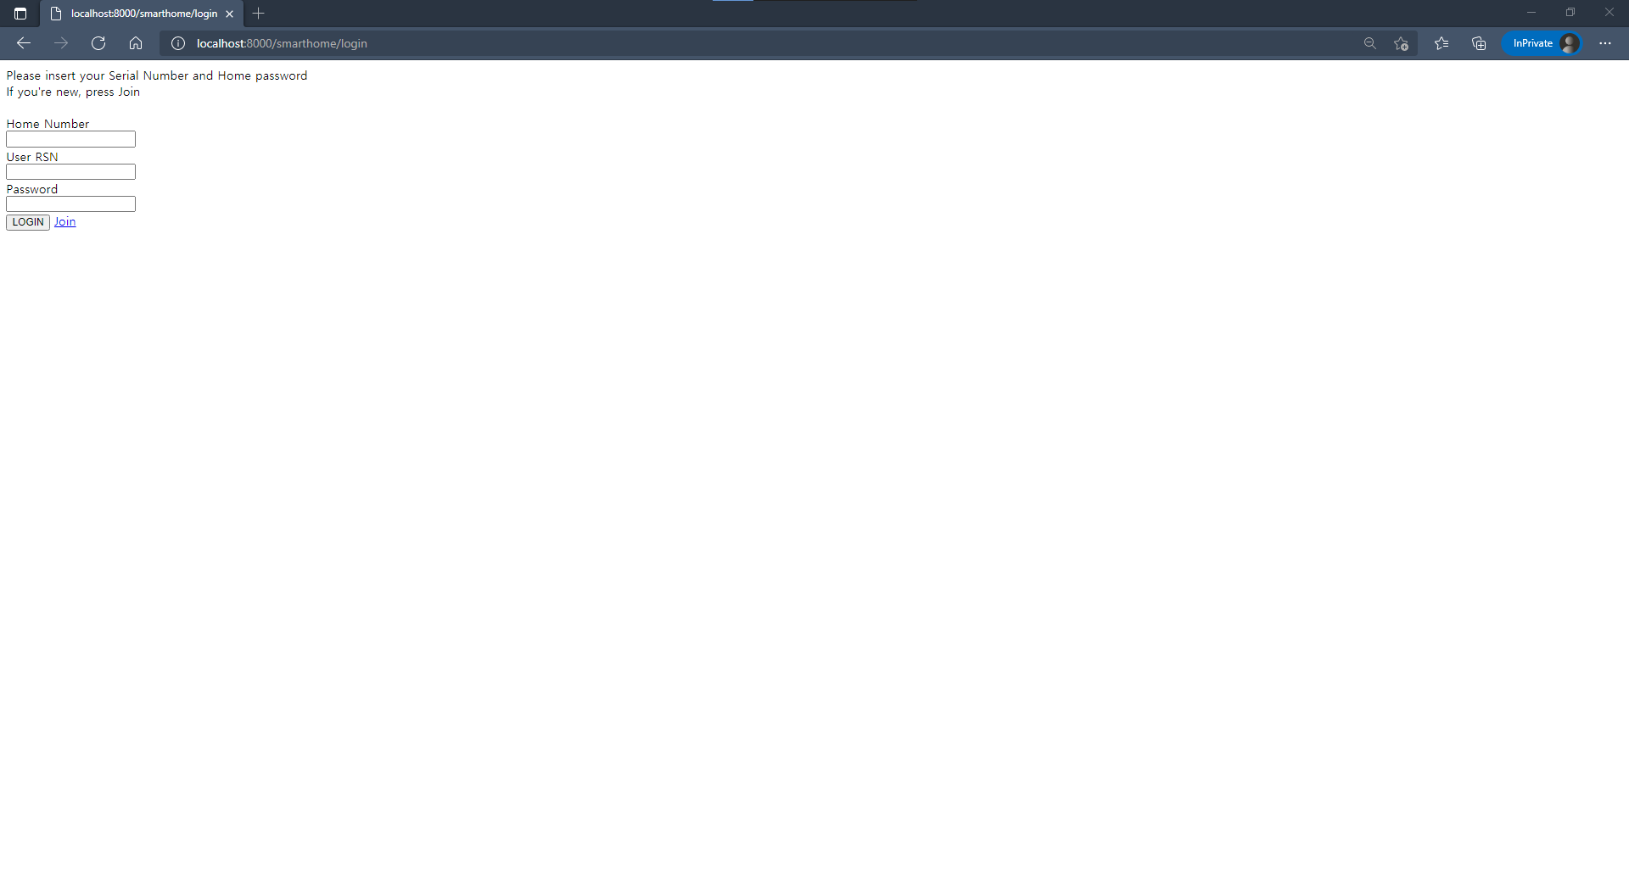
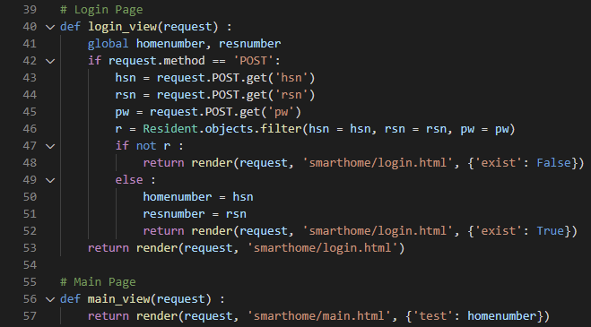
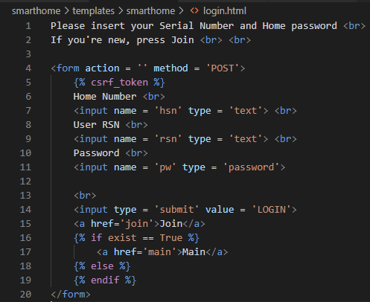
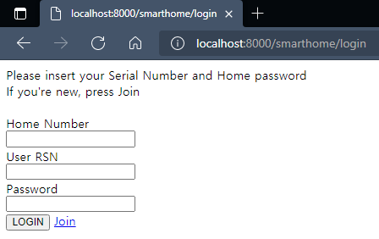
Login Page Interface
Page Interface
Python
HTML
UI

Slide 13
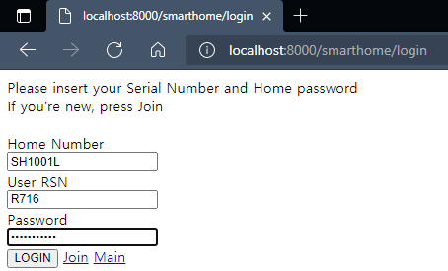
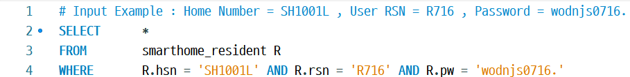
Login Page Query
Page Query

Slide 14
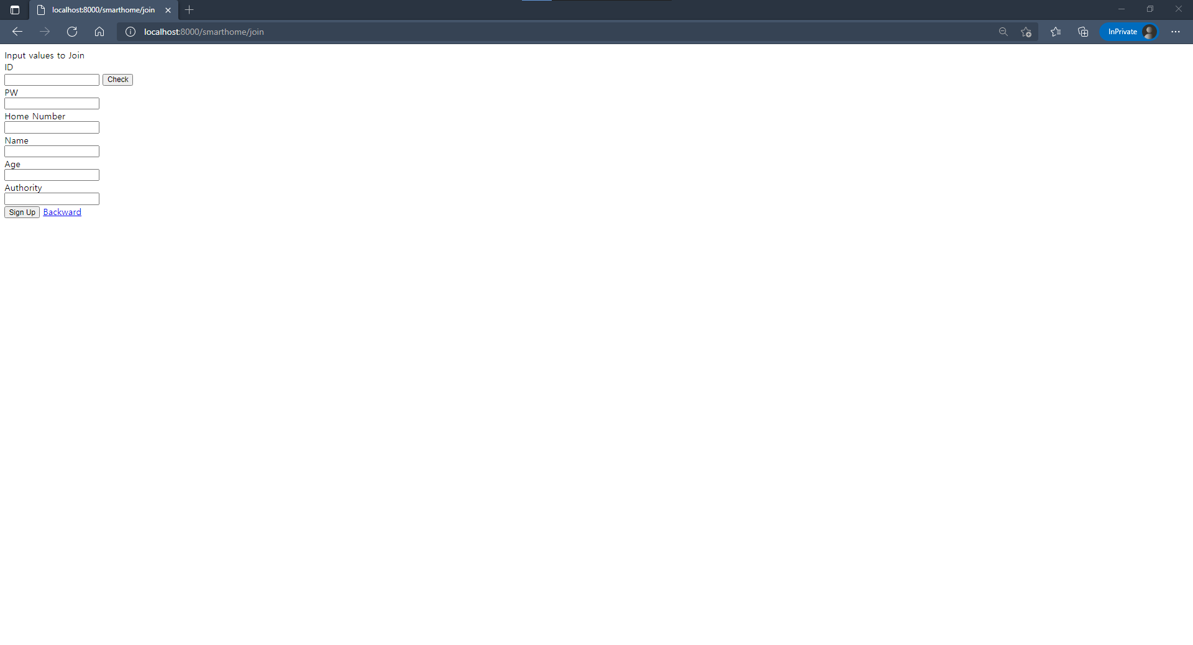
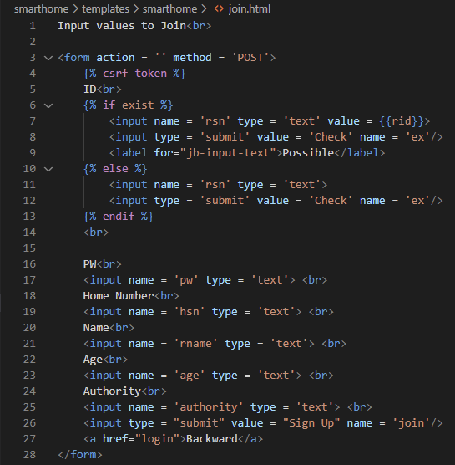
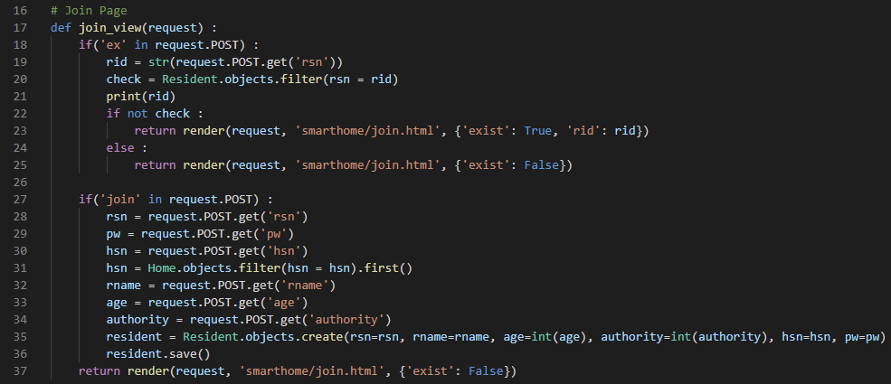
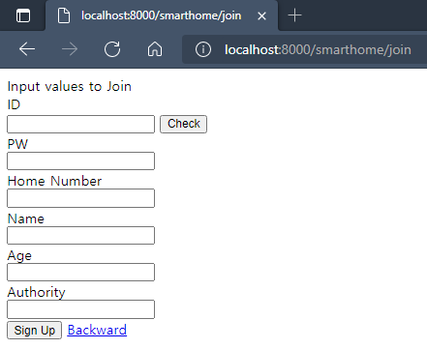
Join Page Interface
Page Interface
HTML
Python
UI

Slide 15
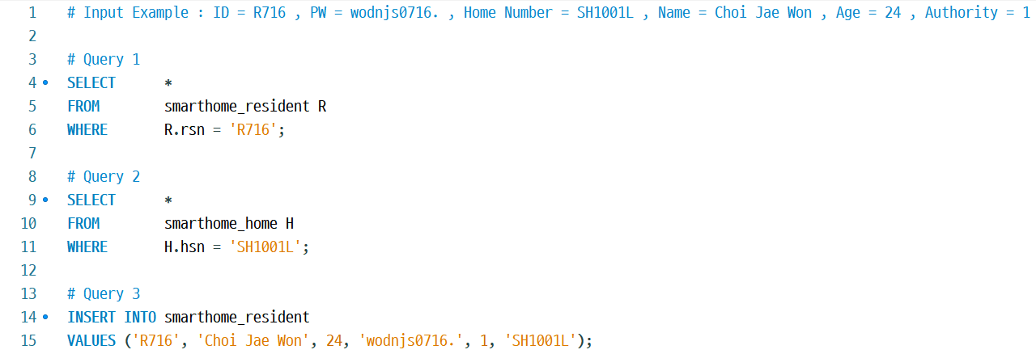
Join Page Query
Page Query

Slide 16
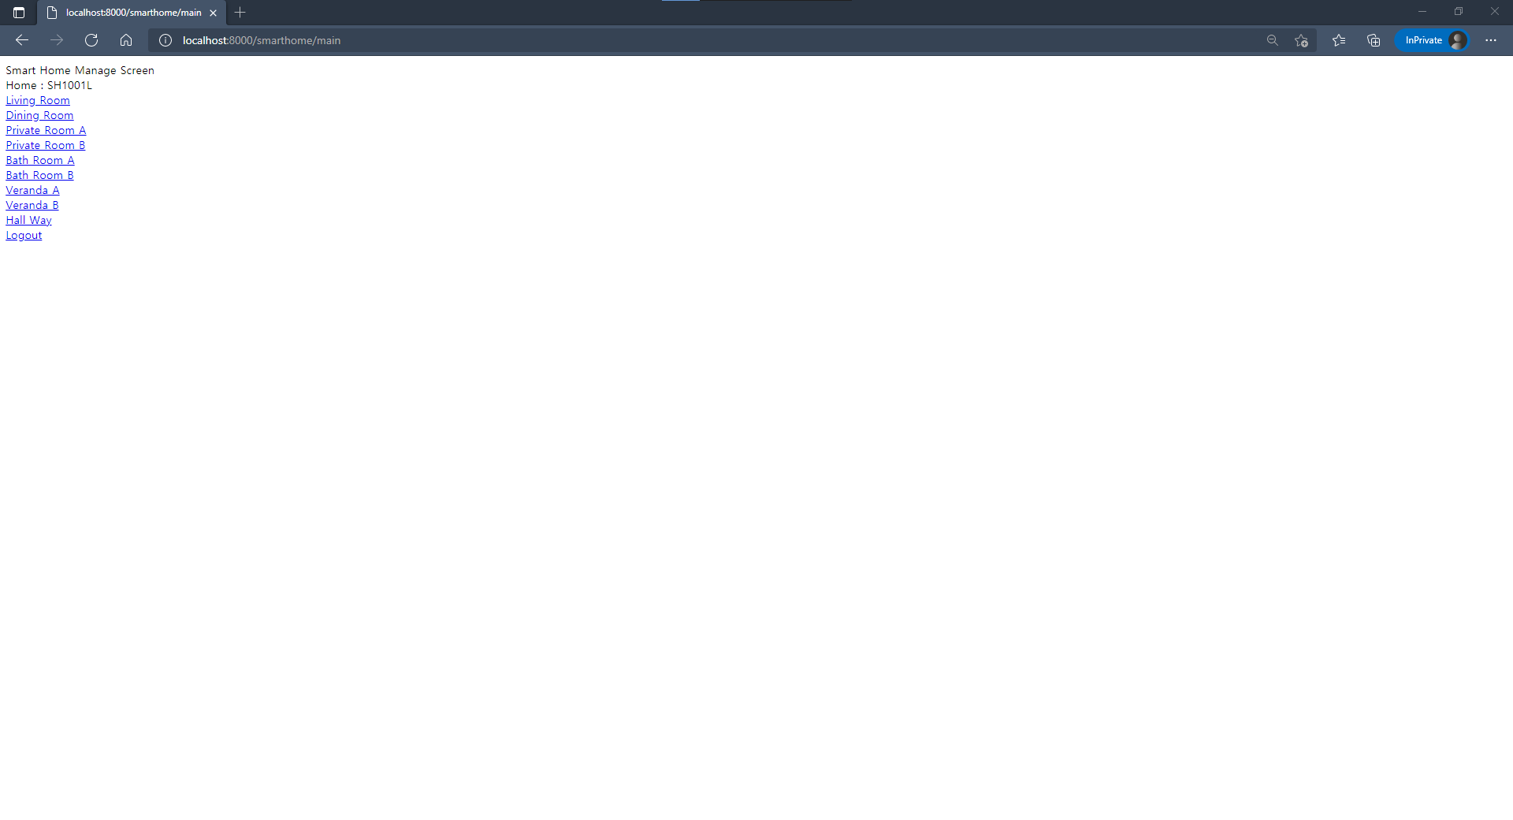
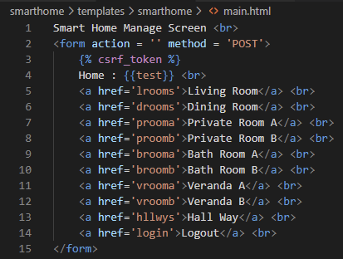
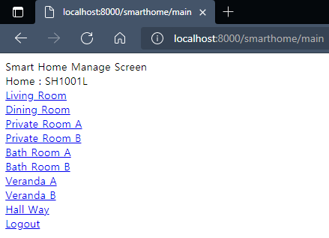

Main Page Interface
Page Interface
HTML
UI
Python
No
Query

Slide 17
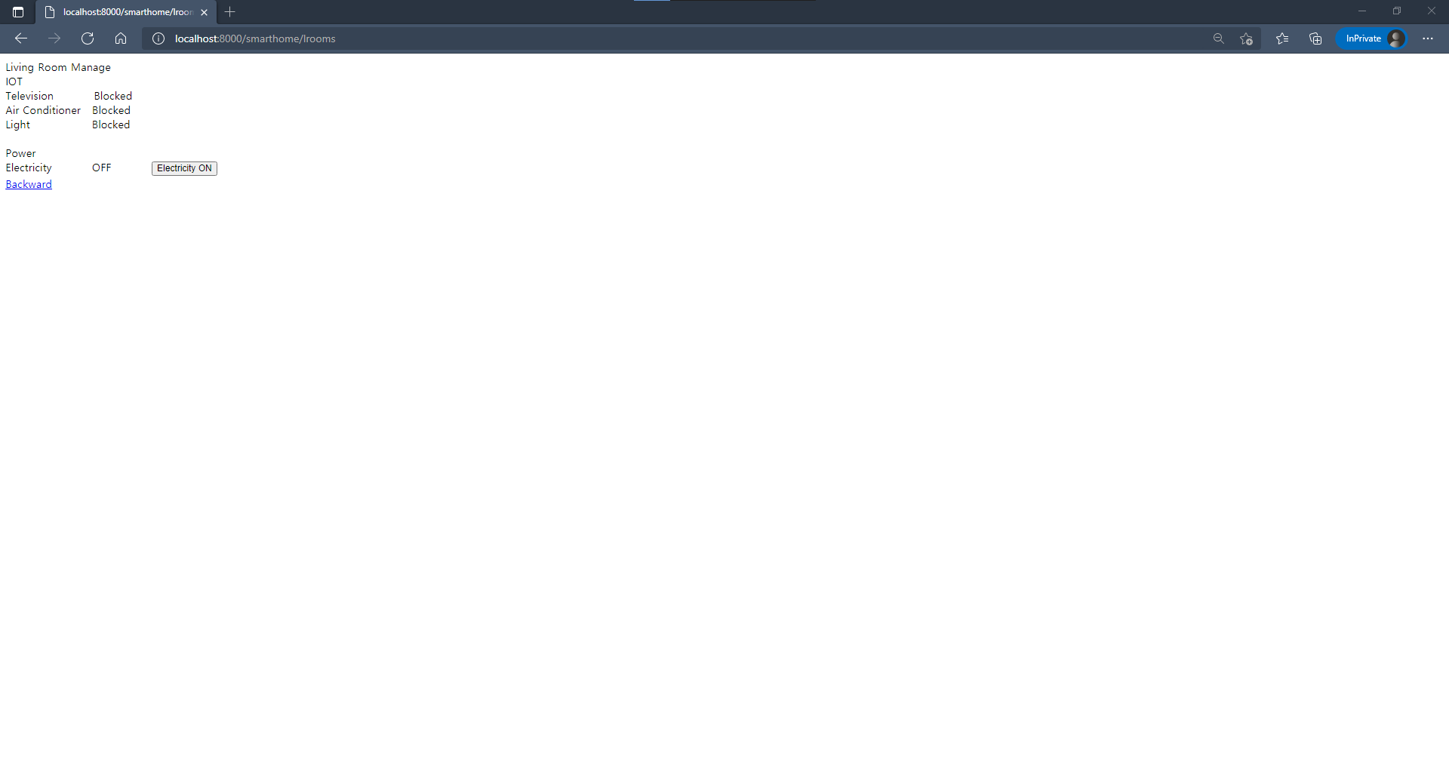
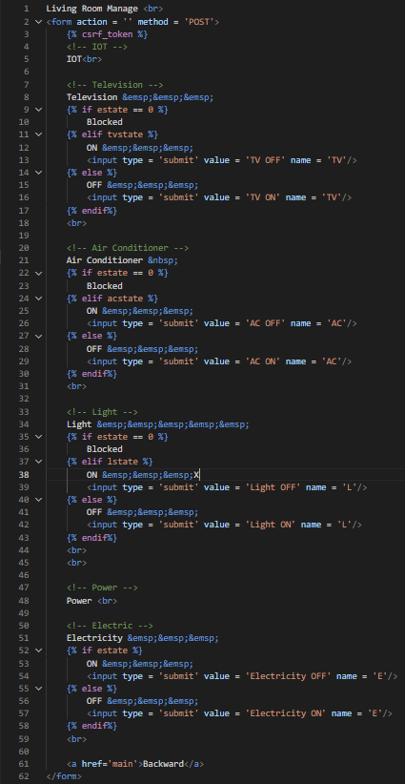
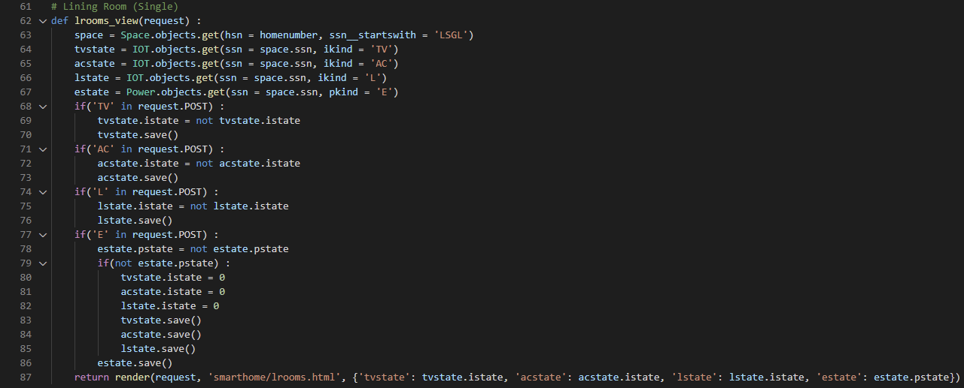
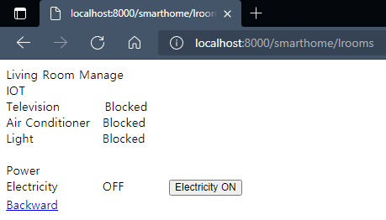
Living Room Page Interface
Page Interface
Python
UI
HTML

Slide 18
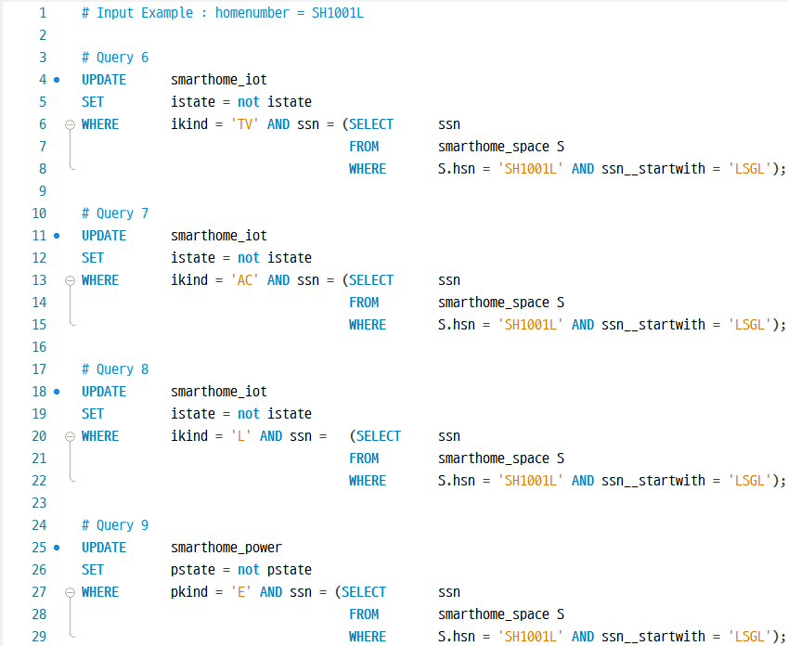
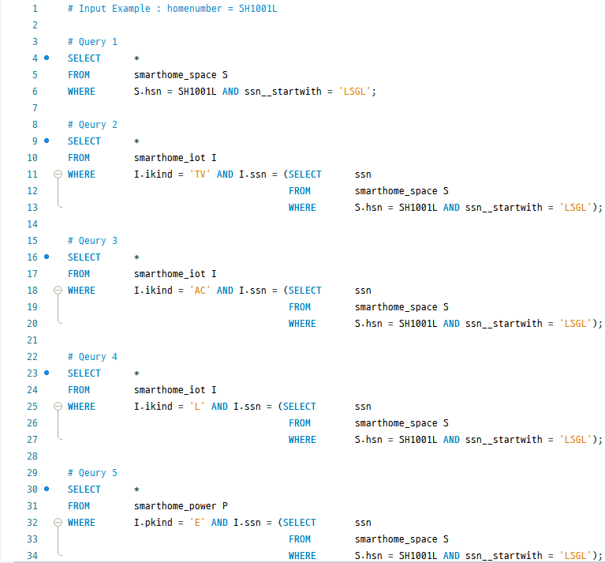
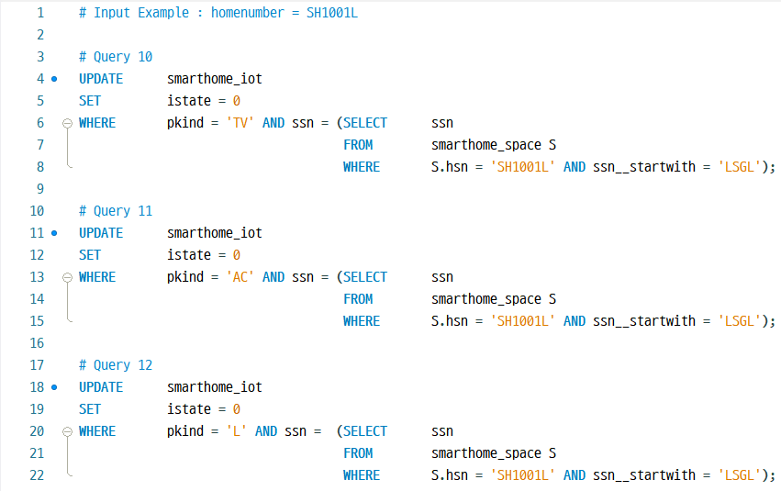
Living Room Page Query
Page Query

Slide 19
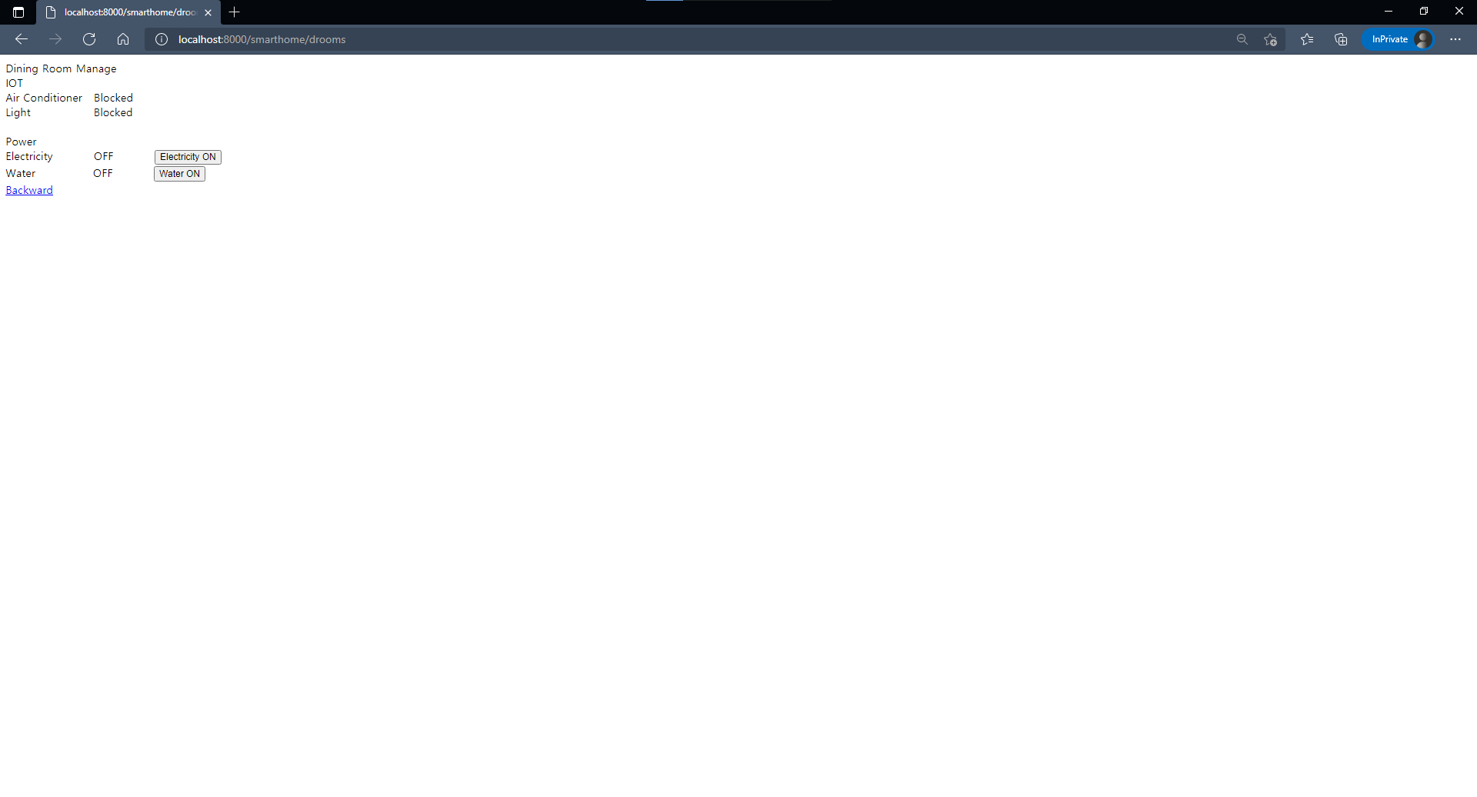
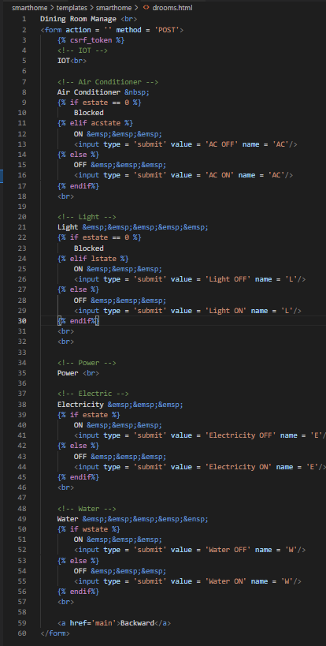
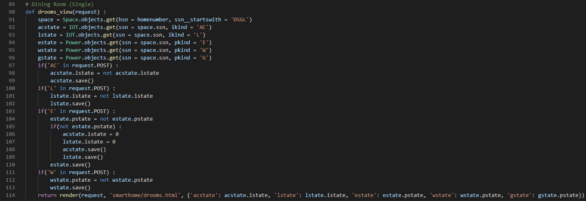
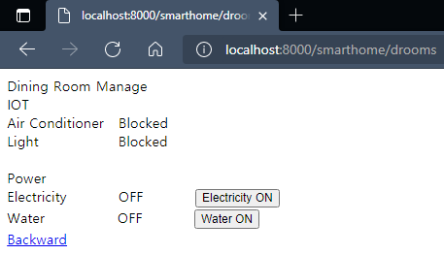
Dining Room Page Interface
Page Interface
Python
UI
HTML

Slide 20
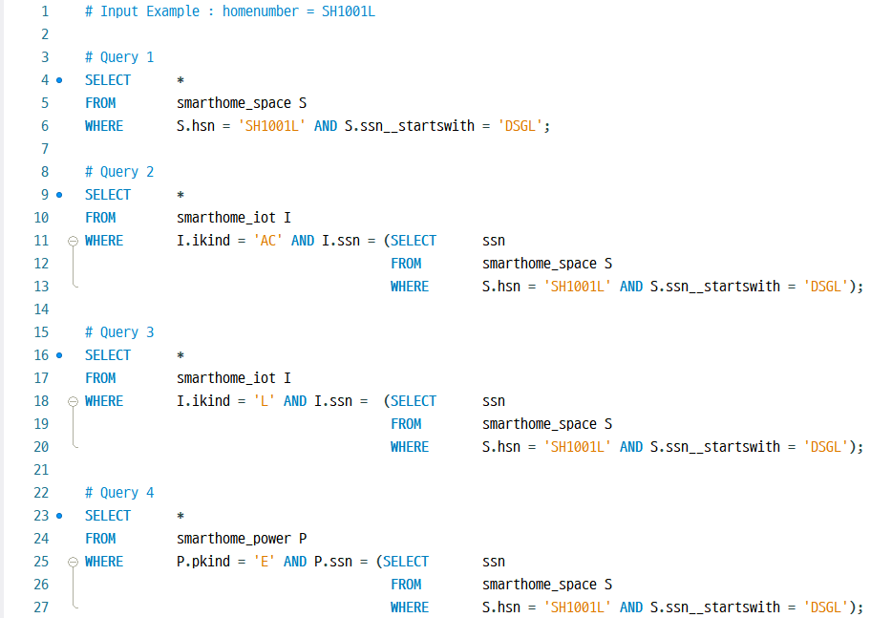
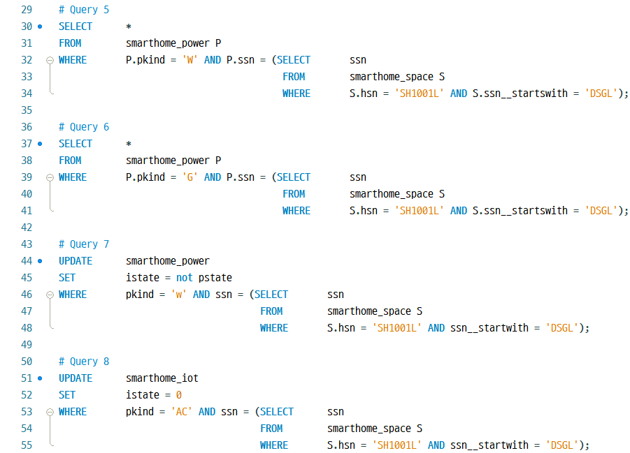
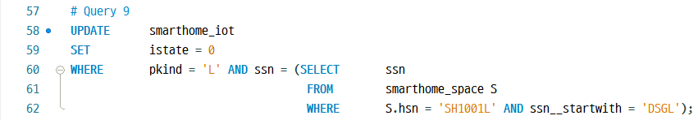
Dining Room Page Query
Page Query

Slide 21
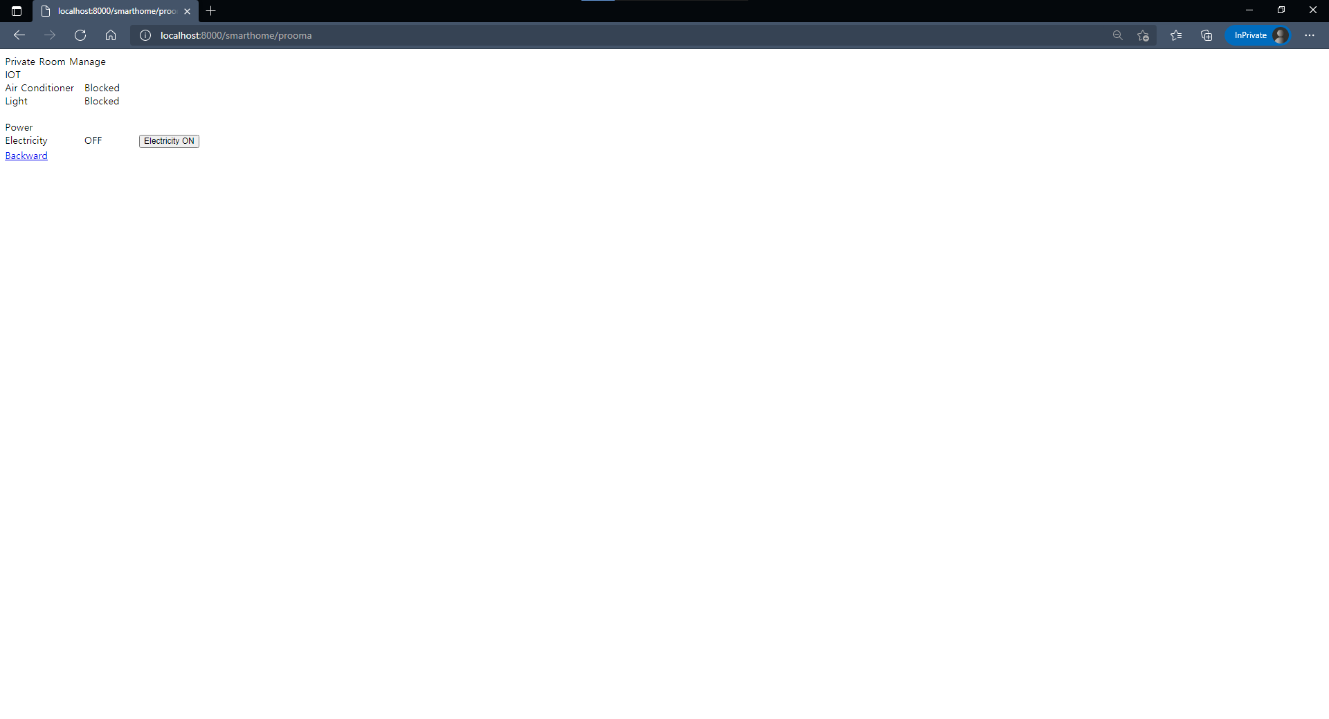
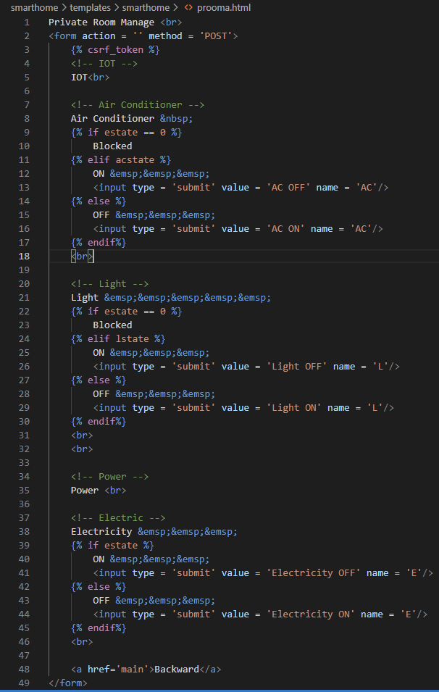
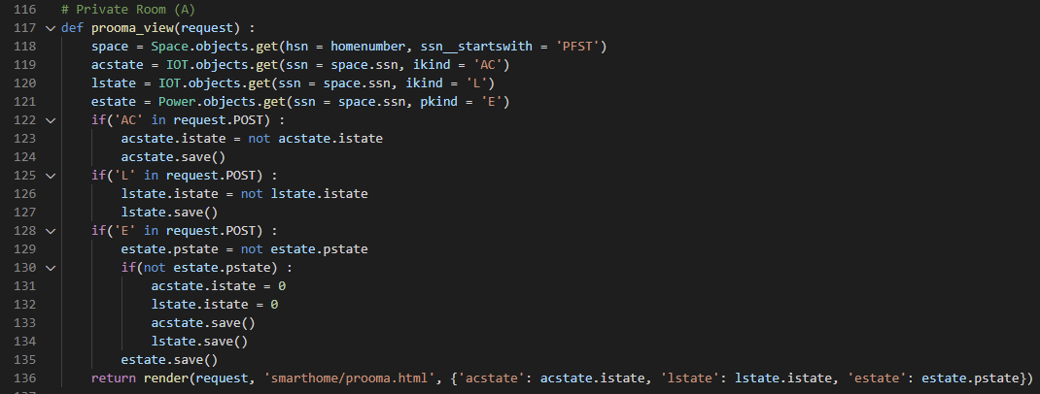
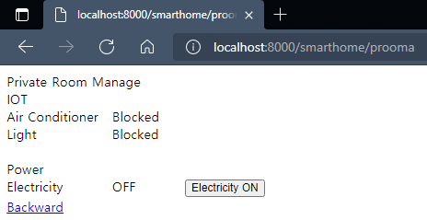
Private Room Page Interface
Page Interface
Python
UI
HTML

Slide 22
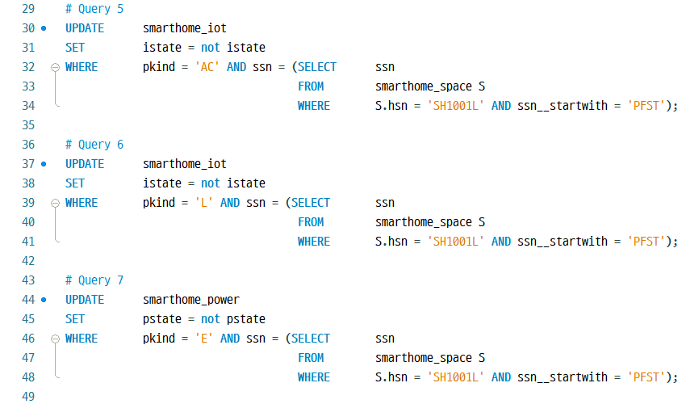
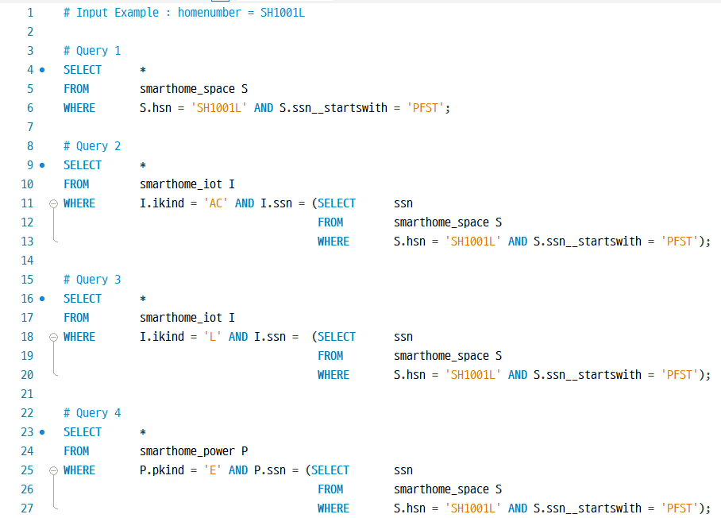
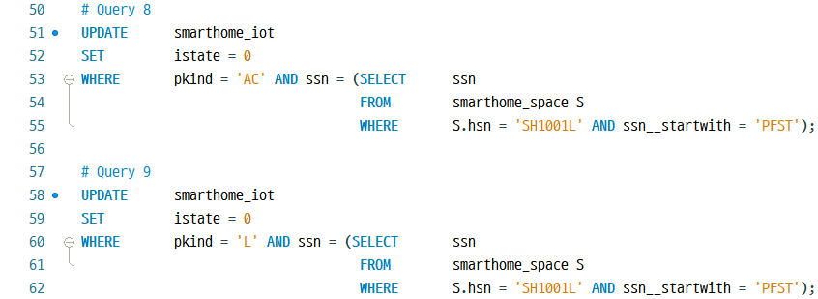
Private Room Page Query
Page Query

Slide 23
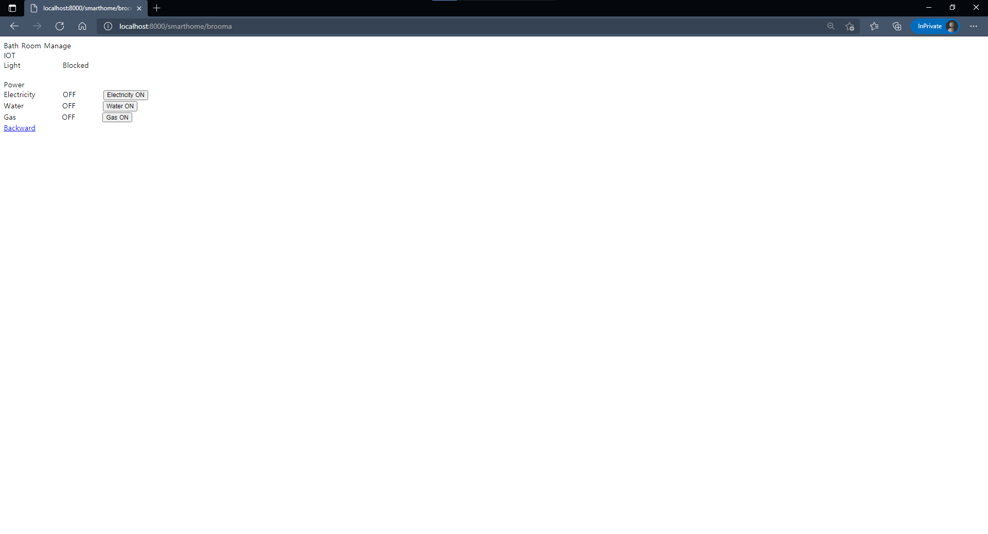
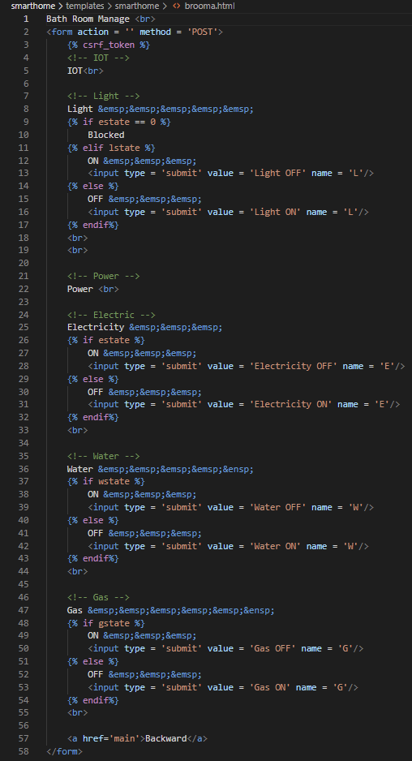
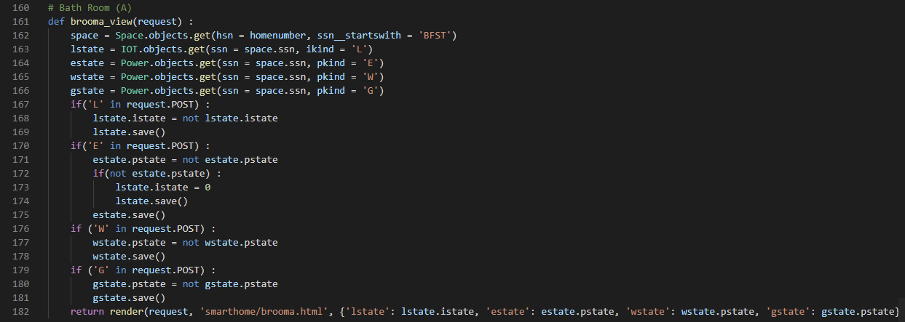
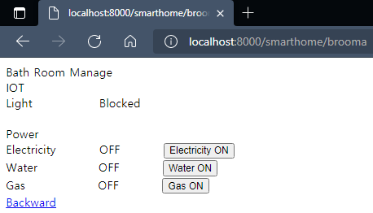
Bath Room Page Interface
Page Interface
Python
UI
HTML

Slide 24
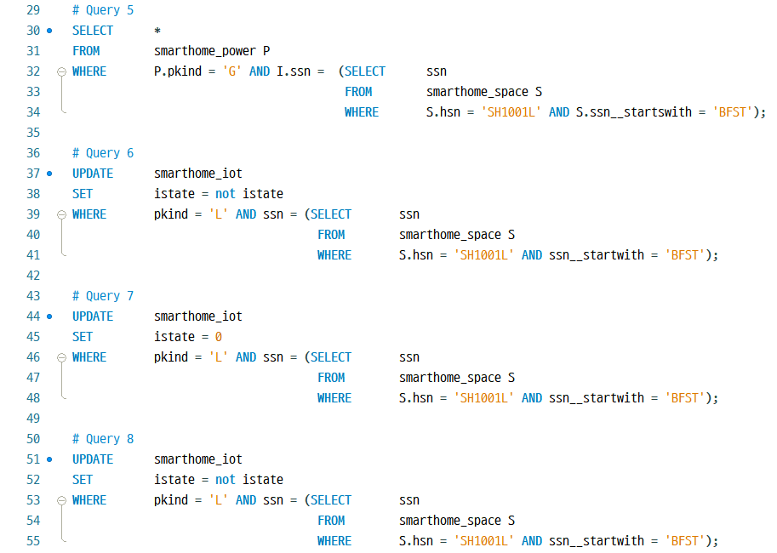
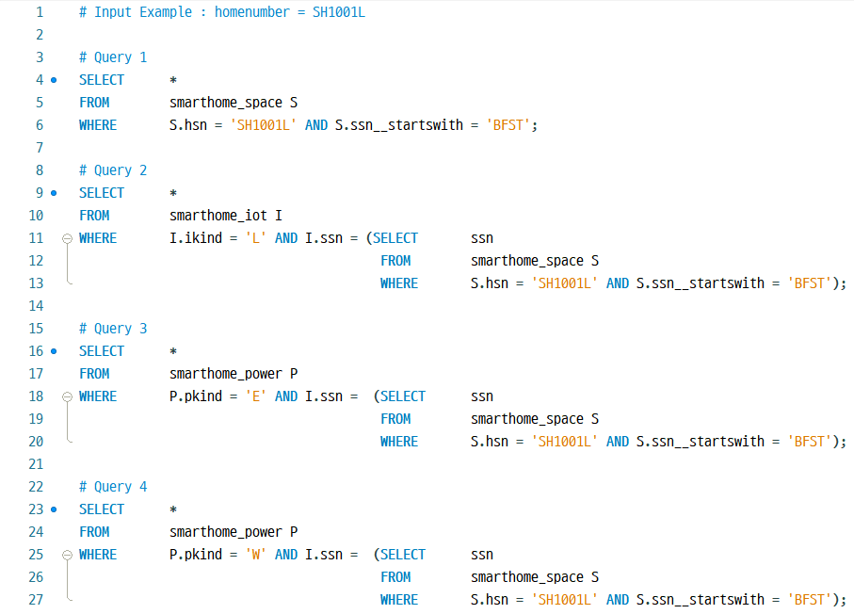
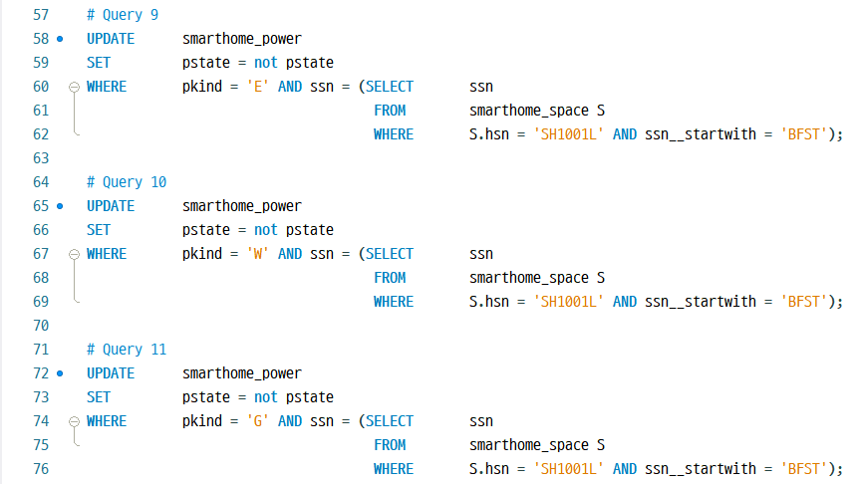
Bath Room Page Query
Page Query

Slide 25
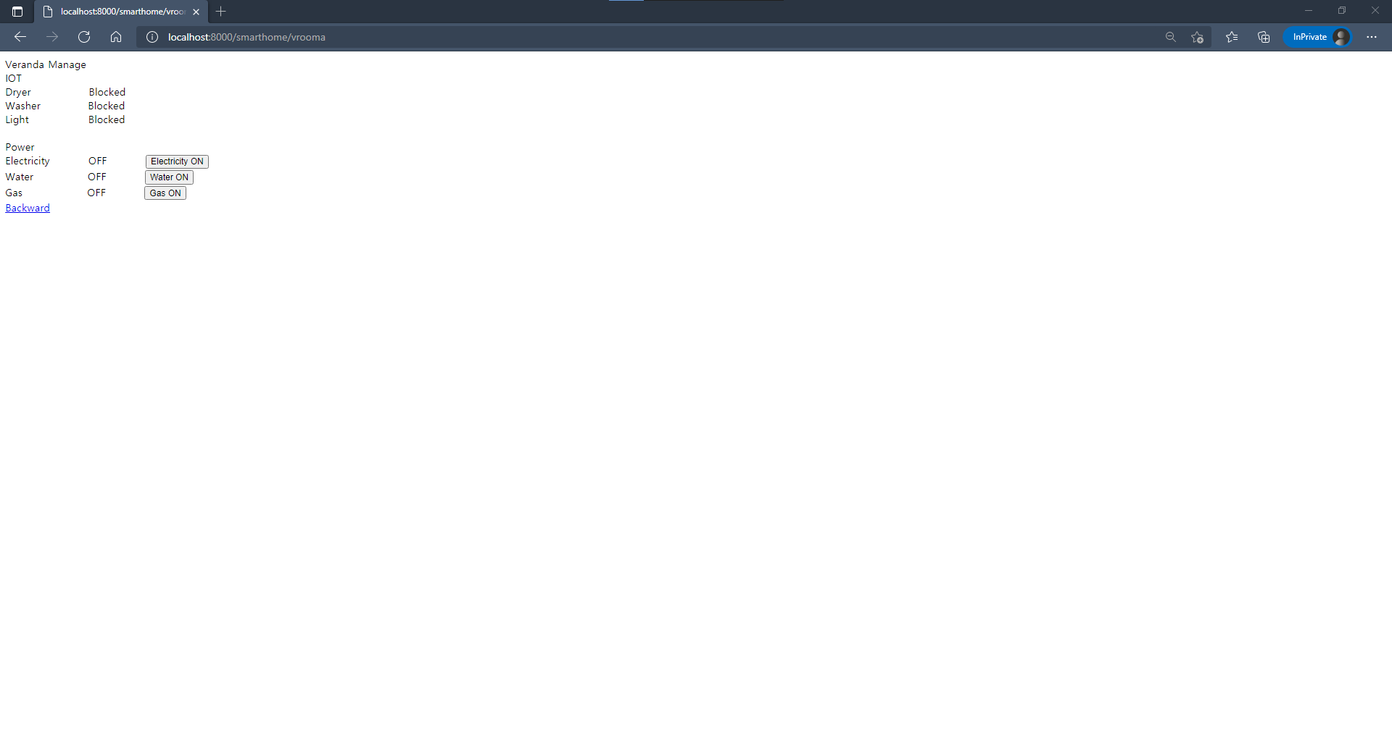
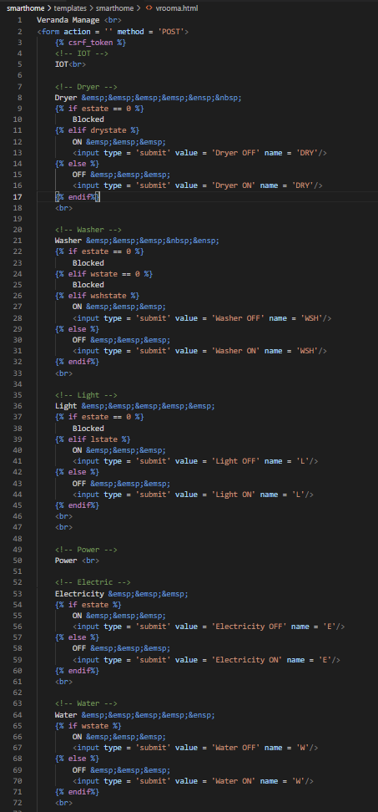
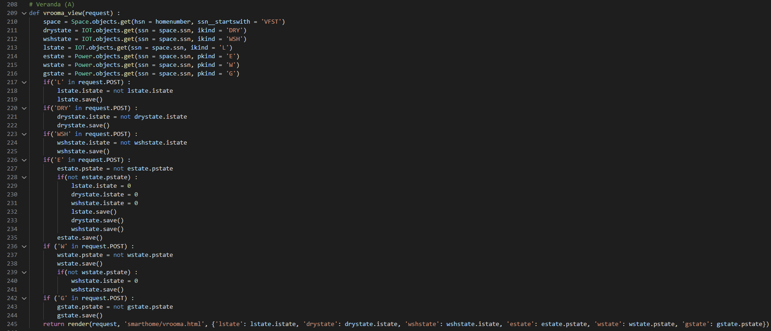
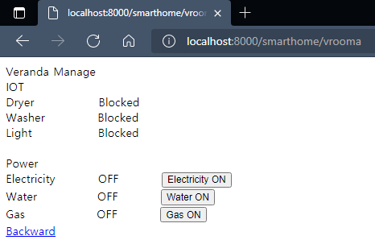
Veranda Page Interface
Page Interface
Python
UI
HTML

Slide 26




Veranda Page Query
Page Query

Slide 27




Hallways Page Interface
Page Interface
HTML
Python
UI

Slide 28


Hallways Page Query
Page Query

Slide 29
Database System
MySQL
Connection
Database

Slide 30



Database System
Using Systems
Python
MySQL
Java
Data
Manage
Database
System
Data
Input

Slide 31
Database
Basic Schema
power
space
smarthome
home
resident
iot

Slide 32





MySQL
Creating Tables in MySQL

Slide 33


Connection
Connecting with Python
settings.py
models.py

Slide 34






Connection
Connecting with Java

Slide 35
Server System
Connection
Server

Slide 36







Server System
Basic Concept
manage.py
settings.py

Slide 37

Connection
Basic Concept
Server Connect

Slide 38
Python Django URL Path
URL

Slide 39

URL
Python Django URL Path
urls.py

Slide 40
Execute Website
Execute

